Slide 1
NDA Update
Simon Napper
Stakeholder Relations
Sizewell Site Stakeholder Group
15 March 2023

Slide 2
NDA Update
UK Government
Whole team of civil servants concerned with nuclear in BEIS have moved into the Department for Energy Security and Net Zero (DESNZ)
Secretary of State is Grant Shapps, who was SoS at BEIS
New minister for nuclear has been announced. He is Andrew Bowie who has been appointed Minister for Nuclear and Networks.
Perm Secs Clive Maxwell (previously in BEIS) and Jeremy Pocklington (previously DCMS but before that DECC)

Slide 3
NDA Update
Stakeholder Survey
NDA commissions an independent organisation to survey stakeholders every two years
800 people took part, 200 more than the last survey. Mix of key stakeholders and those on our mailing list to receive updates electronically.
Key indicators all up since last time – trust, transparency and openness.
We also asked people where we could improve: one of the key findings was that they wanted to know more about mission delivery and how we solve technical challenges, so we will address that.

Slide 4
NDA Update
Stakeholder Summit
After the event in Edinburgh last September, NDA has decided that the next in-person Stakeholder Summit will be held in Cumbria in 2024.
There will be an online, virtual Summit this year, probably in October.
During the year, though, we will be holding a series of in-person, regional meetings for stakeholders. It is planned these will be linked to universities with a nuclear science department, so that we can showcase the links between NDA, research and innovation.
More details as soon as we have them.

Slide 5
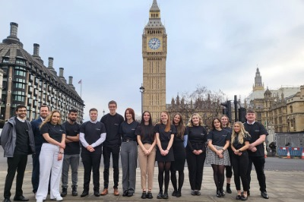
NDA Update
NIA Week in Parliament
The Nuclear Industry Association annually organises a series of events to draw the sector to MPs’ attention. The latest was this January.
NDA sponsored a reception for Parliamentarians highlighting the decommissioning aspects of nuclear.
NDA sponsored the Skills Fair and brought graduates and apprentices to London for them to meet their local MP – and for the MPs to understand the work of the NDA in their communities.

Slide 6
NDA Update
NDA and new nuclear
We are still awaiting news from the Government about when Great British Nuclear will be set up and what its remit will be.
In the meantime, we are being approached by a number of developers and technology providers about the availability of land on our sites.
We are providing publicly available information on an open and transparent basis to enquirers.
We are continuing to support Cwmni Egino, in line with the Memorandum of Understanding between BEIS, NDA and Cwmni Egino.

Slide 7
NDA Update
Decommissioning and waste management consultation
Government consultation on decommissioning and waste management has been published. This updates, consolidates and introduces new options.
Has been agreed by UK Government, Scottish Government and Welsh Government. The 1995 paper was issued before devolution: waste management, though, is a devolved responsibility. This paper aligns policy to current situation
This is a full 12-week consultation. Engagement is being led by Government. Requests for meetings about the consultation can be made by email to: RSNDPolConsult@beis.gov.uk

Slide 8
NDA Update
NDA Graduate Scheme
The challenge of ensuring NDA and its operating companies have sufficient highly-skilled and motivated personnel over several generations as it fulfils its mission is one of its priorities.
In January it launched a new group-wide graduate programme to help ensure a continued flow of young people into the business.
Applications are now open for roles in around 20 different professional disciplines at various locations in all corners of the UK.
The new programme, supported by NDA subsidiary Energus, will offer three placements in different parts of the group. It will operate alongside the graduate schemes run by other operating companies.

Slide 9
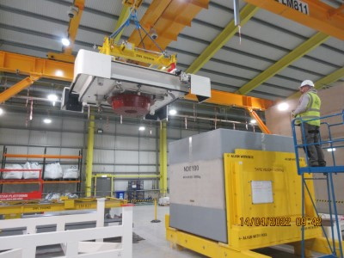
NDA Update
Concrete box
The first concrete box of radioactive waste has been filled and transferred into the purpose-built waste store at Berkeley site.
The project involved the development of a brand new waste storage package and innovative waste retrieval techniques.

Slide 10
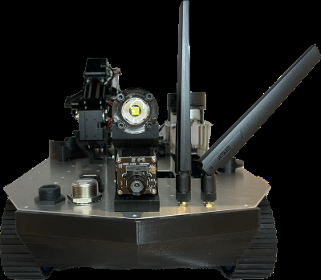
NDA Update
Robots in a radioactive environment
A robot designed with help from Dounreay to safely inspect hazardous environments is in Time Magazine’s top 200 innovations of 2022.
The robot, known as Lyra, has been used to inspect ventilation ducts and feedback radiological information. Human access to this area is currently impossible due to the size of the duct and radiological risks.

Slide 11
NDA Update
Working together to find a solution
Sellafield has contaminated chemical waste in stores on site. There was no compliant way to transport these to other locations.
Working with another group company, Nuclear Waste Services, the existing TC14 waste drum was redesigned to carry inner containers of plastic, metal, or glass containing the chemicals.
For Sellafield, this means greater efficiencies – they are able to pack more into the containers, and the approach will significantly reduce the time it will take for them to safely store these chemicals. It is a good example of the increased collaborative working across OneNDA.

Slide 12
