Slide 1
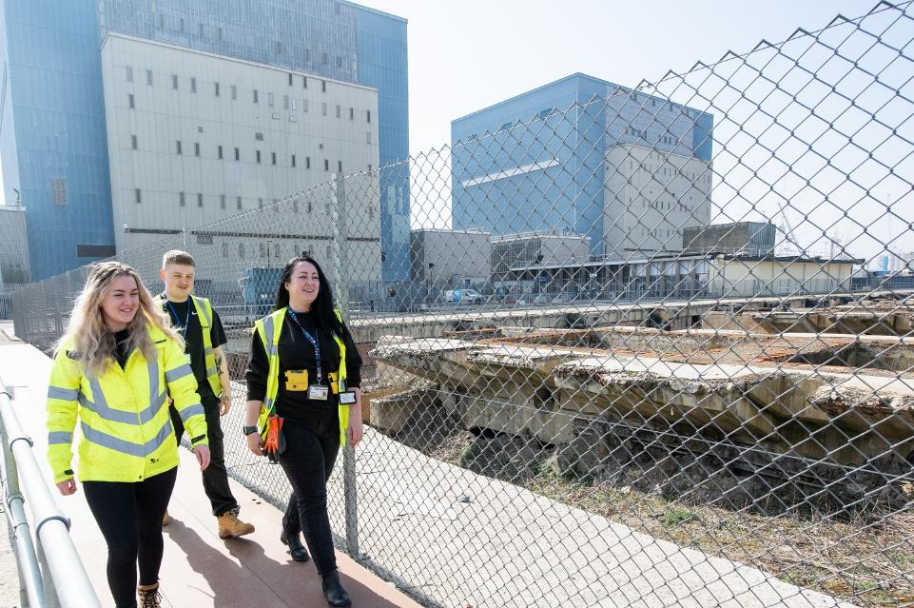
Site Stakeholder Group
June 2023
1
Notes:
1

Slide 2
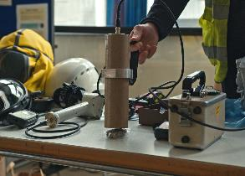
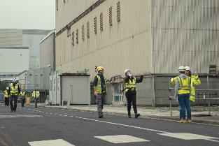
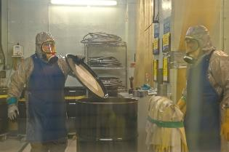
Site Overview
Safety, Security & Environment; Regulatory Issues:
  Hand trap event, resulting in broken finger
  ONR Enforcement Letter (LC26) – good progress on close-out and embedding an enduring culture programme
  Anomaly found in arrangements for maintenance of gaseous sampling equipment
Resourcing & Recruitment
  All baseline roles filled
  “Hinkley A School” – investing in our people. Local recruitment campaigns for operators and radiological protection technician trainees, apprentices and graduates through Energus, internal progression opportunities.
Delivery Progress
  Installation and commissioning of Modular ILW Encapsulation Plant (MILWEP), Pre-Conditioning Facility (PCF), Settling Tank (ST) Retrievals complete
  Asbestos remediation in Boiler Houses in final year
  First waste package in the ISF 2023
21/06/2023
2

Slide 3
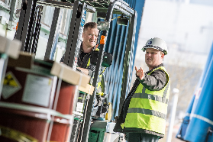
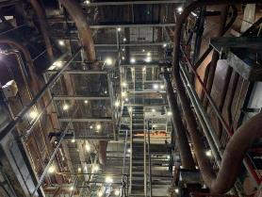
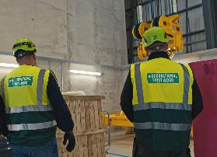

Safety, Security & Environment
Safety Performance:
  TRIR = 0.30 / DACR = 0
  KPIs & DPSI Indicators typically green with no clear adverse trends
  EHSS&Q Independent Site Inspector ratings for the site either green or improved in reporting period in almost all areas
Significant Events:
  Hand trap event resulting in broken finger
Regulatory Issues:
  ONR Enforcement Letter [LC26]: good progress on actions, targeted at: enduring safety culture programme (setting to work, human performance); organisational capability
  EA informed of anomalies in the arrangements for maintenance of gaseous discharge equipment; investigations are ongoing
3
Notes:
Thanks for doing Host briefs
EHSSQ Exec visit
3

Slide 4
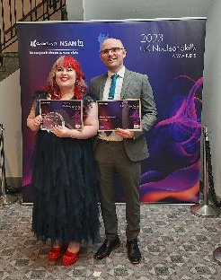
People
Recruitment and retention environment challenging
  “Hinkley A School” continuing to invest in existing staff and local community to address local and national skills shortages.
  Local recruitment campaigns for operators and radiological protection technician trainees.
Apprentices & STEM:
  Finalist Apprentice at NSAN National Apprentice Awards
  Apprentice assessment complete for HPA and cross-site (HPA/B) maintenance technician roles
  Several summer work experience placements arranged
People Plan
  People Management coaching to support retention and
  employee value
  Embedding an enduring culture programme, starting with
  Psychological Safety and Setting to Work training
21/06/2023
4

Slide 5
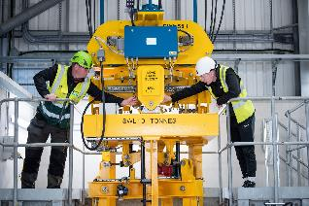

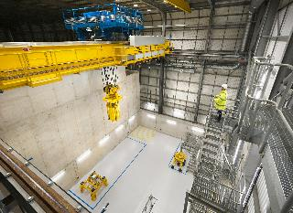
Plant & Progress
Progress continues in
  Asbestos remediation – Boiler Houses and surrounding plant areas
  Fuel Element Debris (FED) retrievals
  Installation and commissioning of Waste processing facilities
  Waste storage – first waste package in the ISF 2023
  Asset condition monitoring and maintenance
Site sustainability / energy efficiency action plan
No planning applications to discuss
Opportunities for waste synergies across HPA / HPB discussed
21/06/2023
5

Slide 6
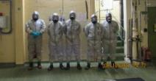

Hinkley Targets 2023/24
People Plan
20%
Enduring culture programme
25%
Settling Tank 9:* Ready to commence active commissioning
Pre-Conditioning Facility: *
Complete installation
Asbestos Remediation: *
R1B Stage 3 Clearance,
Clear 7000m²
80%
65%
20%
Dry Vault Retrieval: * Full Business Case submitted to BEIS
FED: *
ILW Retrieval 9.5Te
Fire system:
Replace obsolete detection system (part 1)
MSS Review & Update
Site C&M entry date April 2039
Critical path through Dry Vaults, with all waste projects as sub-critical activities
100%
29%
7%
Dry Vault Enablers: ADF & Skip store decabling
MAETP:
Ready to commence active commissioning
JWMP: *
8 shipments / 6m³ legacy waste
15%
50%
10%
21/06/2023
6
Notes:
6

Slide 7
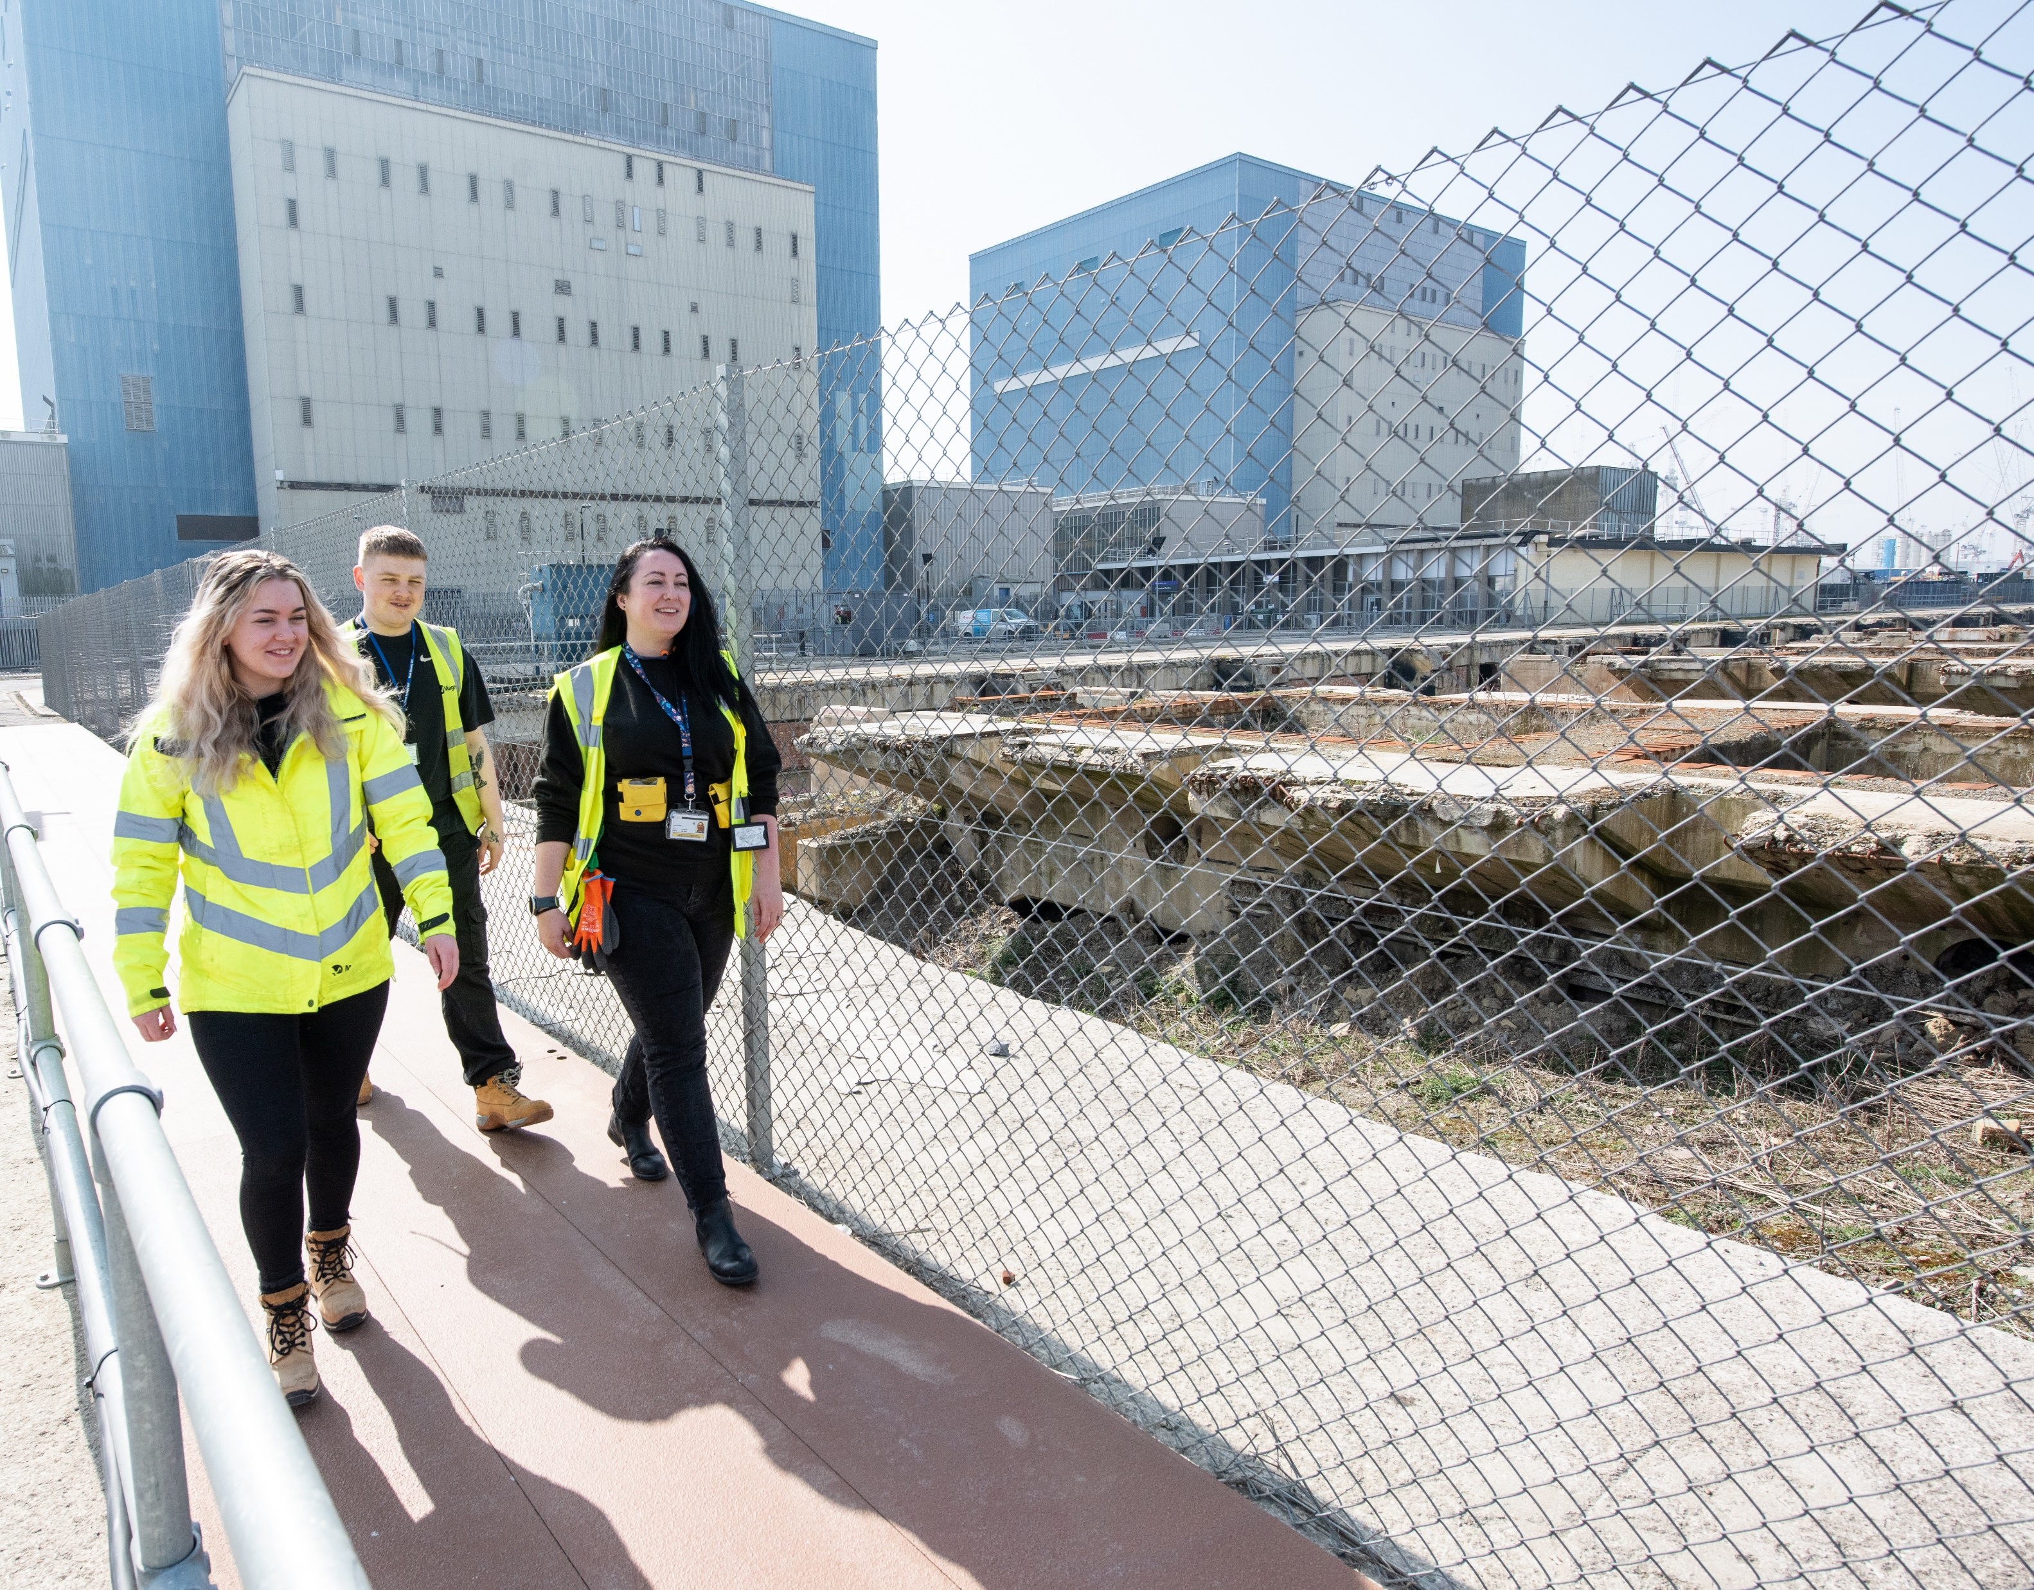
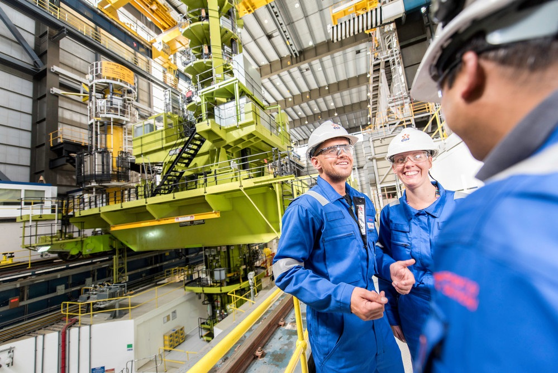
Transition and transfer
After defueling, ownership of each advanced gas-cooled reactor (AGR) station, including Hinkley Point B, will be transferred to the Nuclear Decommissioning Authority (NDA) with Magnox becoming the licensee and carrying out decommissioning.
Magnox has built a positive and collaborative relationship with EDF and have an agreed joint seamless transition and transfer programme including dedicated workstreams.
Magnox are working with EDF and NDA to ensure alignment and are working together on plans for the transition and transfer of Hinkley Point B which is expected around 2026.

Slide 8
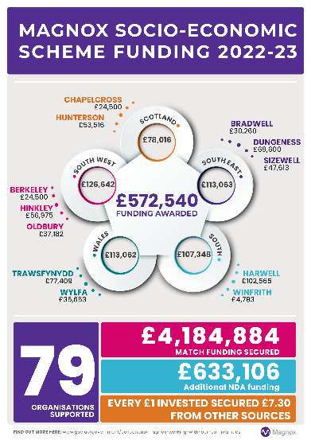
Magnox Socio-economic Funding Support
2022 – 2023
Funding allocation across 12 Magnox sites £1,020,035 (forecast reduced to £770,035)
Year-end spend across Magnox site 2023/24 £572,540 (including £171,750 multi-year projects).
5 Successful applications for Hinkley A total £56,975
To-date 2023 – 2024
Somerset Education Business Partnership £48,750 year 2 (£195k over 4 years)
For further information please go to:
  https://www.gov.uk/government/collections/magnox-working-with-our-communities
8

Slide 9
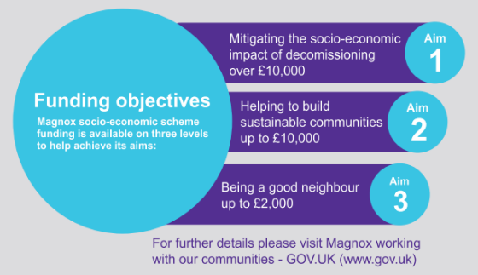
Please note:
NDA Socio-economic Strategy Refresh 2023-24
Under the Energy Act (2004), the NDA has a socio-economic role which recognises the importance of delivering the decommissioning programme in a socially responsible way. The approach to this is explained in the NDA Local Social and Economic Impact Strategy which was last published in July 2020.
Since then, much has happened to shape the economic challenges, opportunities, and priorities in the communities around the NDA estate. The NDA is commencing a refresh of the Local Social and Economic Impact Strategy.
Over the coming months the NDA wish to engage with stakeholders across the UK to better understand the social and economic priorities in our communities to identify priority areas of focus, to align our internal processes and systems, and to make best use of the funding available across the group for maximum community benefit. Once developed, the new strategy will be subject to a period of public consultation before it is finalised and published.
Magnox funding objectives remain the same
21/06/2023
9
Notes:
9

